Slide 1
Finding the maximum bounded intersection of k out of n halfplanes
Peter Brass, Hyeon-Suk Na
Information Processing Letters 110 (2010) 113–115
Speaker: Chong-Jie Wang
Date: Jan. 5, 2010

Slide 2
Abstract
In this note we study the following question: Given n halfplanes, find the maximum-area bounded intersection of k halfplanes out of them. We solve this problem in O(n³k) time and O(n²k) space.

Slide 3
Theorem 1. Given n halfplanes, we can find the maximum-area bounded intersection of k halfplanes out of them, in O(n³k) time and O(n²k) space.

Slide 4
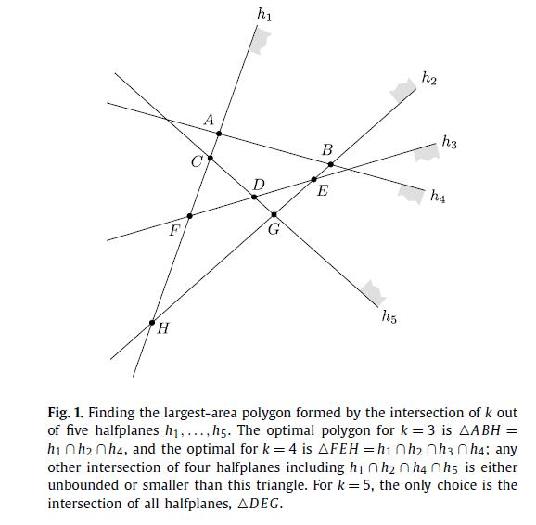

Slide 5
H(t) be the halfplane of points with x-coordinate not greater than t, and let l(t) be its bounding line.
A_{t} (a, b, c) : the maximum-area of any bounded intersection of H(t) with c out of H₁, . . . , H_{n}, among which Ha, H(t), and Hb occur consecutively in the clockwise ordering of (c+1) outer normals.
So A_{t} (a, b, c) is the area of some polygon bounded by l_{a}, l(t), l_{b}, and c−2 other linesegments to the left of
l(t), or 0 if no such polygon exists.

Slide 6
As a preprocessing step, we generate all intersection points li ∩ lj and sort them by x-coordinate in nondecreasing order, and for each intersection point, we compute how many halfplanes H_{r} satisfy H_{i} ∩ H _{j} ⊆ H_{r} . This can be done in O(n³) time and requires Θ(n²) space.

Slide 7
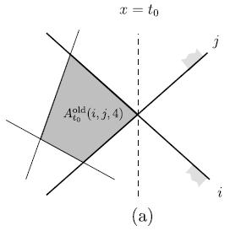
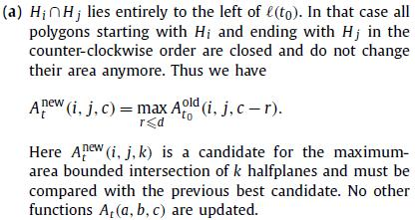

Slide 8
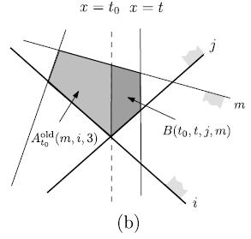
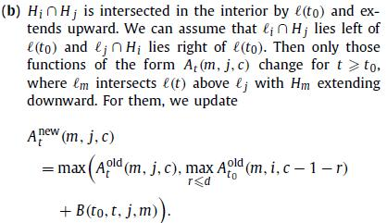

Slide 9
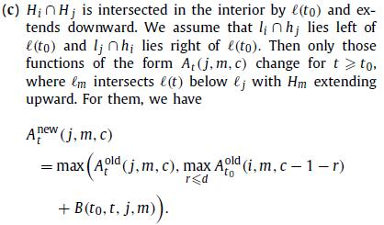
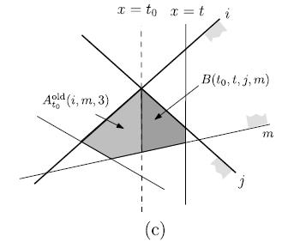

Slide 10
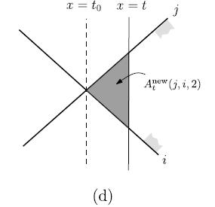


Slide 11
Conclusion
There are Θ(n²) intersection points (events) in total, and at each intersection point li ∩ lj we update the coefficients of O(nk) functions At (a, b, c) such that {i, j} ∩ {a, b} = ∅. Therefore the sweeping step requires in total O(n³k) time and O(n²k) space, and so does the whole algorithm.

Slide 12
Thank you!

